Slide 1
Image Encryption using Triple DES
Name: Ashish Golsangi

Slide 2
Triple Data Encryption Standard
Triple DES is an encryption algorithm based on the original Data Encryption Standard (DES). It is a symmetric encryption algorithm that uses multiple rounds of the Data Encryption Standard (DES) to improve security. It is also known as Triple DES because it uses the Data Encryption Standard (DES) cypher which takes three times to encrypt its data. It is essentially a block cypher used to encrypt data in 64-bit blocks

Slide 3
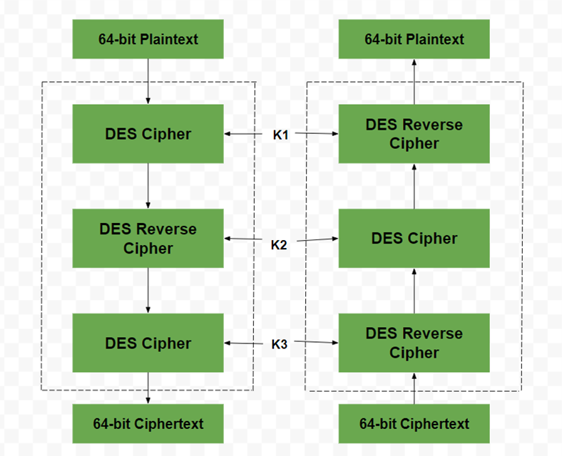

Slide 4
Features of Triple DES:-
It utilizes a triple layer of encryption which means it utilizes three different keys to encrypt the plaintext three times.
It supports variable key sizes which range from 128 bits to 192 bits.
It basically involves the usage of a symmetric key encryption system, which states that the same key is used for both encryption and decryption.
It is a block cypher encryption algorithm that works with 64-bit blocks of plaintext at a time.
It is suitable for legacy systems that require secure encryption.

Slide 5
Implementation of Triple DES
To implement Triple-DES (3DES), you would typically follow these steps:
1. Key Generation: Generate three 64-bit keys (K1, K2, K3) for the encryption process.
2. Encryption Process:
- Initial Permutation: Permute the input plaintext according to a fixed table.
- Round 1: Encrypt the permuted plaintext using Key K1.
- Round 2: Decrypt the output of Round 1 using Key K2.
- Round 3: Encrypt the output of Round 2 using Key K3.
- Final Permutation: Permute the output of Round 3 to get the ciphertext.

Slide 6
3. Decryption Process:
- Initial Permutation: Permute the input ciphertext according to a fixed table.
- Round 1: Decrypt the permuted ciphertext using Key K3.
- Round 2: Encrypt the output of Round 1 using Key K2.
- Round 3: Decrypt the output of Round 2 using Key K1.
- Final Permutation: Permute the output of Round 3 to get the original plaintext.

Slide 7
4. Padding: If the plaintext length is not a multiple of the block size (64 bits), padding may be required to fill the last block.
5.Mode of Operation: Choose a mode of operation like CBC (Cipher Block Chaining) or ECB (Electronic Codebook) to encrypt multiple blocks of data.
6. Key Management: Ensure secure storage and handling of the three keys to maintain the security of the encryption process.

Slide 8
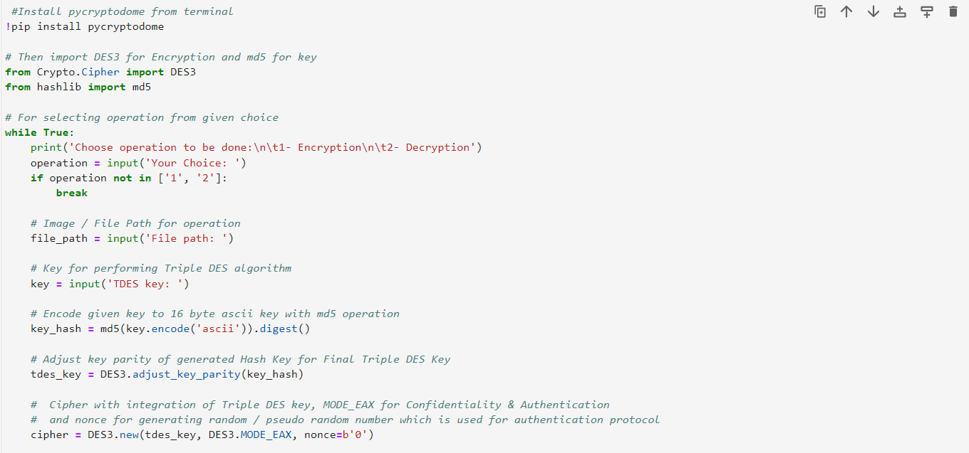
Implementation in Python

Slide 9
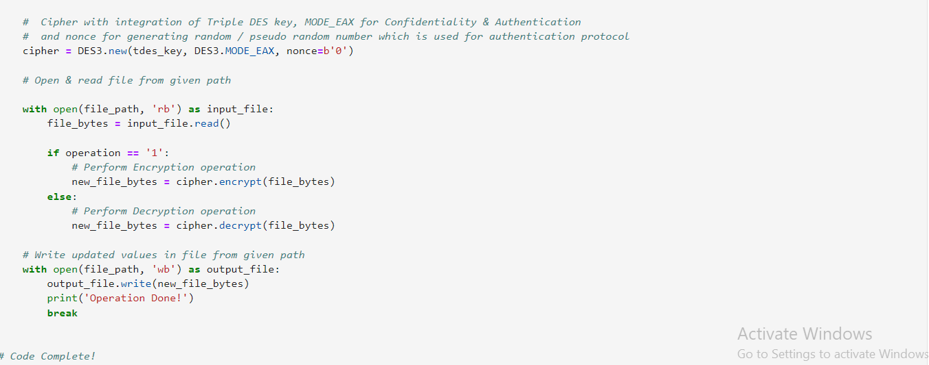

Slide 10
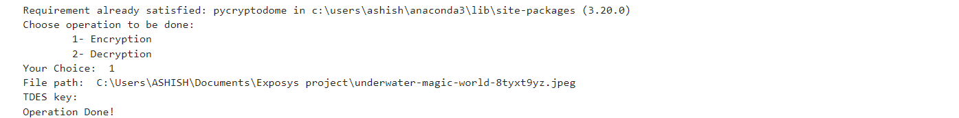
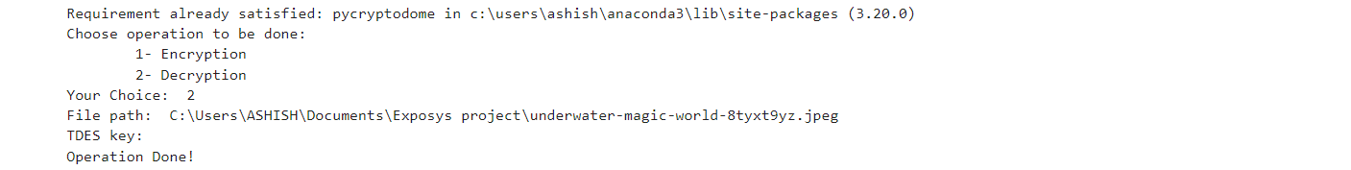
Result

Slide 11


Result

Slide 12
Conclusion
The image encryption scheme using Triple DES provides a robust method for securing visual data. By leveraging the encryption capabilities of Triple DES, the scheme ensures the confidentiality and integrity of images, making them resistant to unauthorized access and tampering. While Triple DES may have some limitations compared to newer encryption algorithms like AES, it remains a viable option, especially in scenarios where compatibility and legacy support are critical

Slide 13
Thank you

